Slide 1
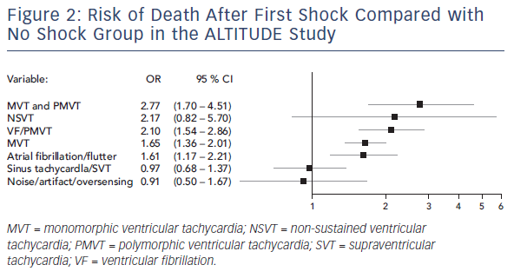
Li AC, Kaura A, Sunderland N, Dhillon PS, Scott PA
Figure 2: Risk Of Death After First Shock Compared With No Shock Group In The ALTITUDE Study
Citation: Arrhythmia & Electrophysiology Review 2016;5(2):110–6
https://doi.org/10.15420/aer.2016.12.2

