Slide 1
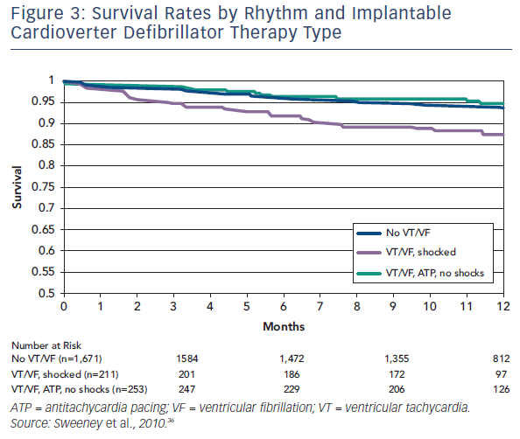
Li AC, Kaura A, Sunderland N, Dhillon PS, Scott PA
Figure 3: Survival Rates By Rhythm And Implantable Cardioverter Defibrillator Therapy Type
Citation: Arrhythmia & Electrophysiology Review 2016;5(2):110–6
https://doi.org/10.15420/aer.2016.12.2

