Slide 1
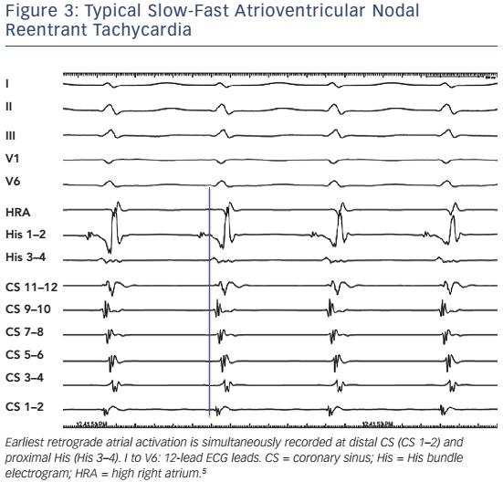
Katritsis DG, Josephson ME
Figure 3: Typical Slow-Fast Atrioventricular Nodal Reentrant Tachycardia
Citation: Arrhythmia & Electrophysiology Review 2016;5(2):130–5
https://doi.org/10.15420/aer.2016.18.2

