Slide 1
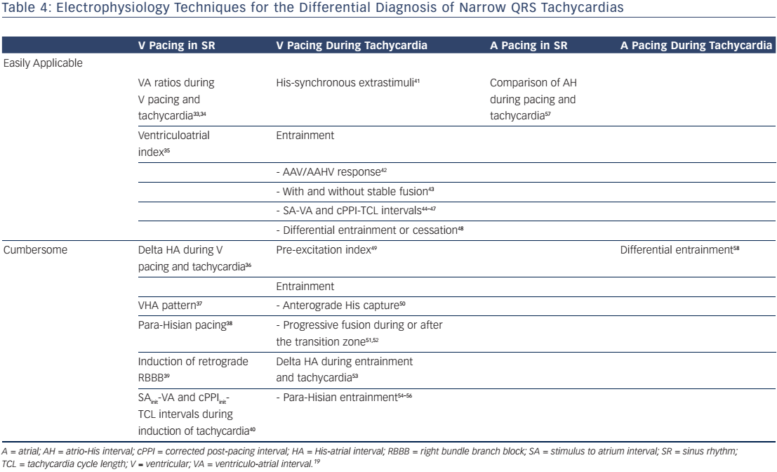
Katritsis DG, Josephson ME
Table 4: Electrophysiology Techniques for the Differential Diagnosis of Narrow QRS Tachycardias
Citation: Arrhythmia & Electrophysiology Review 2016;5(2):130–5
https://doi.org/10.15420/aer.2016.18.2

