Slide 1
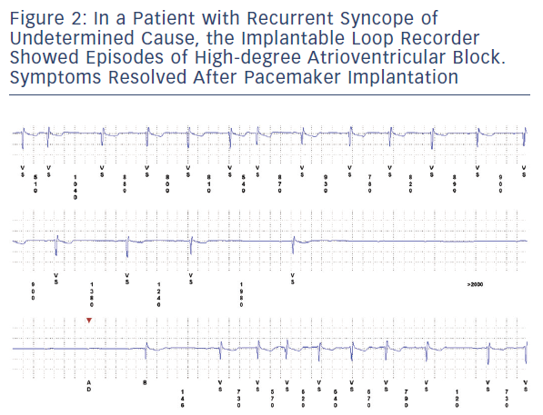
Galli A, Ambrosini F, Lombardi F
Figure 2: In A Patient With Recurrent Syncope Of Undetermined Cause, The Implantable Loop Recorder Showed Episodes Of High-Degree Atrioventricular Block. Symptoms Resolved After Pacemaker Implantation
Citation: Arrhythmia & Electrophysiology Review 2016;5(2):136–43
https://doi.org/10.15420/aer.2016.17.2

