Slide 1
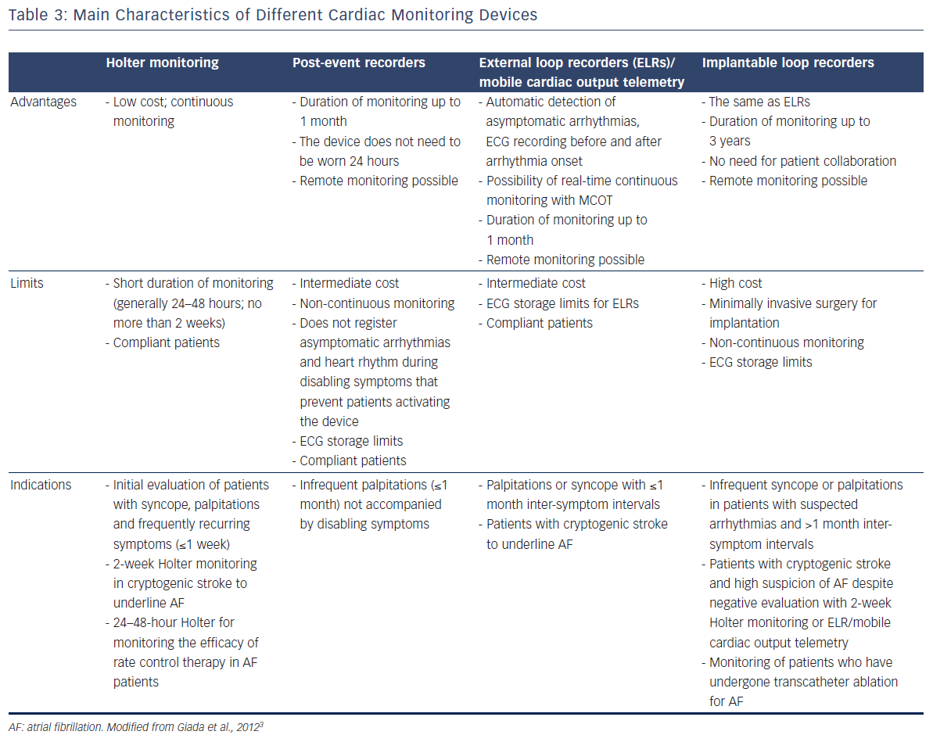
Galli A, Ambrosini F, Lombardi F
Table 3: Main Characteristics Of Different Cardiac Monitoring Devices
Citation: Arrhythmia & Electrophysiology Review 2016;5(2):136–43
https://doi.org/10.15420/aer.2016.17.2

