Slide 1
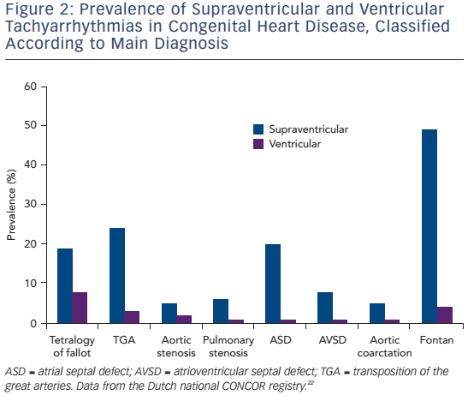
Brouwer C, Hazekamp MG, Zeppenfeld K
Figure 2: Prevalence Of Supraventricular And Ventricular Tachyarrhythmias In Congenital Heart Disease, Classified According To Main Diagnosis
Citation: Arrhythmia & Electrophysiology Review 2016;5(2):150–60
https://doi.org/10.15420/aer.2016.19.2

