Slide 1
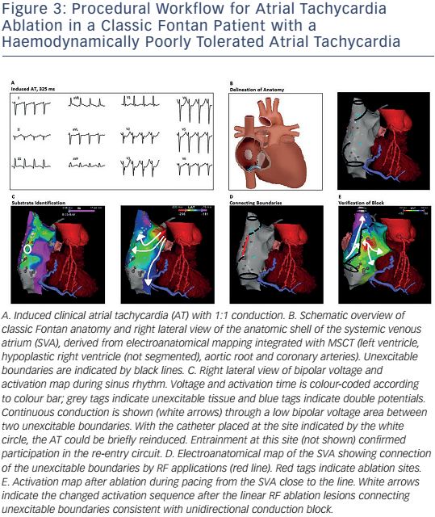
Brouwer C, Hazekamp MG, Zeppenfeld K
Figure 3: Procedural Workflow For Atrial Tachycardia Ablation In A Classic Fontan Patient With A Haemodynamically Poorly Tolerated Atrial Tachycardia
Citation: Arrhythmia & Electrophysiology Review 2016;5(2):150–60
https://doi.org/10.15420/aer.2016.19.2

