Slide 1
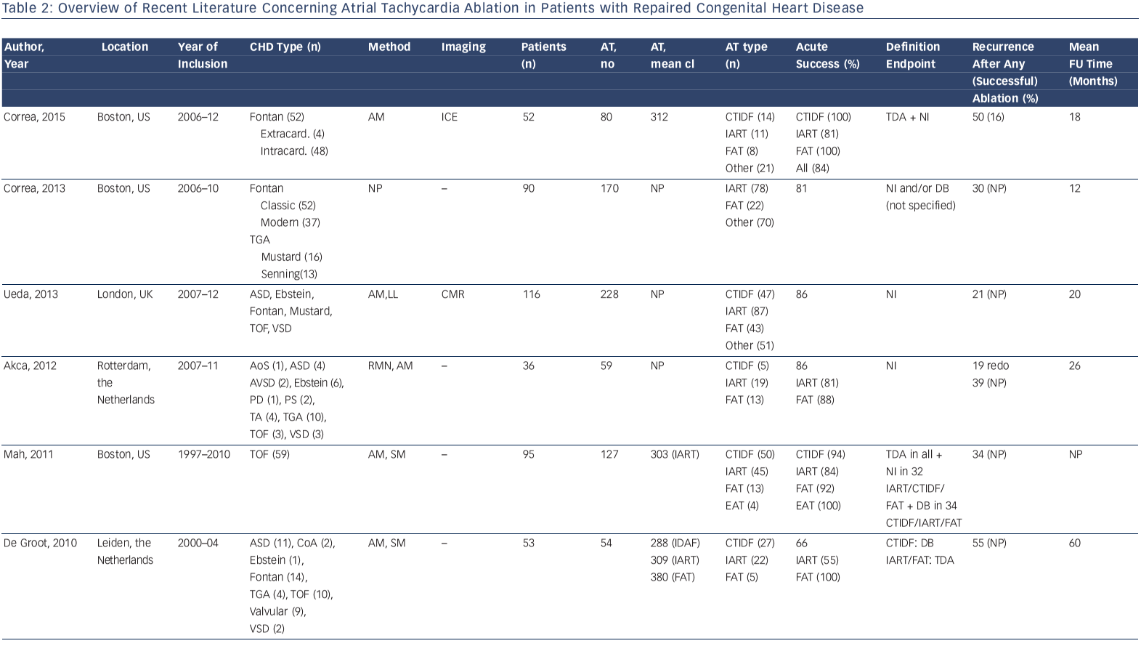
Brouwer C, Hazekamp MG, Zeppenfeld K
Table 2: Overview Of Recent Literature Concerning Atrial Tachycardia Ablation In Patients With Repaired Congenital Heart Disease
Citation: Arrhythmia & Electrophysiology Review 2016;5(2):150–60
https://doi.org/10.15420/aer.2016.19.2

