Slide 1
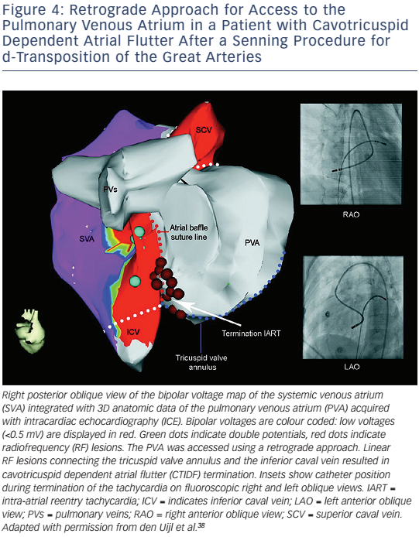
Brouwer C, Hazekamp MG, Zeppenfeld K
Figure 4: Retrograde Approach For Access To The Pulmonary Venous Atrium In A Patient With Cavotricuspid Dependent Atrial Flutter After A Senning Procedure For D-Transposition Of The Great Arteries
Citation: Arrhythmia & Electrophysiology Review 2016;5(2):150–60
https://doi.org/10.15420/aer.2016.19.2

