Slide 1
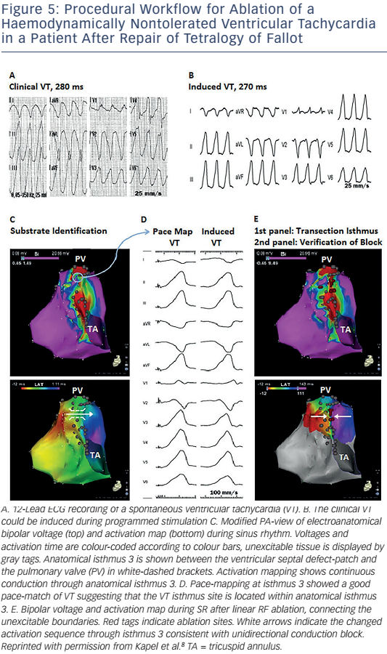
Brouwer C, Hazekamp MG, Zeppenfeld K
Figure 5: Procedural Workflow For Ablation Of A Haemodynamically Nontolerated Ventricular Tachycardia In A Patient After Repair Of Tetralogy Of Fallot
Citation: Arrhythmia & Electrophysiology Review 2016;5(2):150–60
https://doi.org/10.15420/aer.2016.19.2

