Slide 1
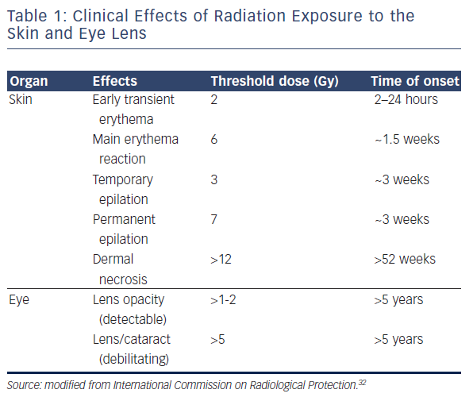
Yamagata K, Aldhoon B, Kautzner J
Table 1: Clinical Effects of Radiation Exposure to the Skin and Eye Lens
Citation: Arrhythmia & Electrophysiology Review 2016;5(2):144–9
https://doi.org/10.15420/aer.2016.16.2

