Slide 1
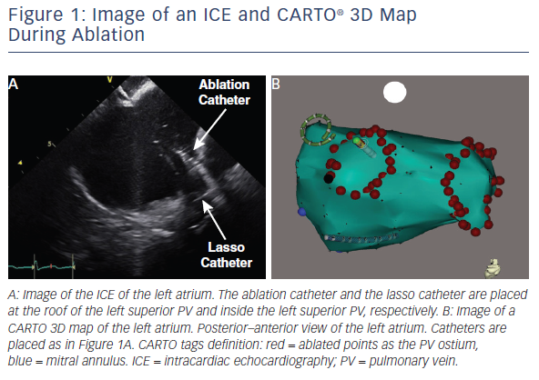
Yamagata K, Aldhoon B, Kautzner J
Figure 1: Image of an ICE and CARTO® 3D Map During Ablation
Citation: Arrhythmia & Electrophysiology Review 2016;5(2):144–9
https://doi.org/10.15420/aer.2016.16.2

