Slide 1
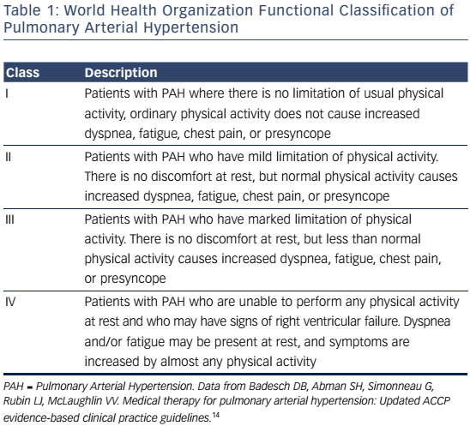
Attridge RL, Moote RD, Levine DJ
Table 1: World Health Organization Functional Classification of Pulmonary Arterial Hypertension
Citation: US Cardiology Review 2016;10(2):78–84
https://doi.org/10.15420/usc.2016:2:2

