Slide 1
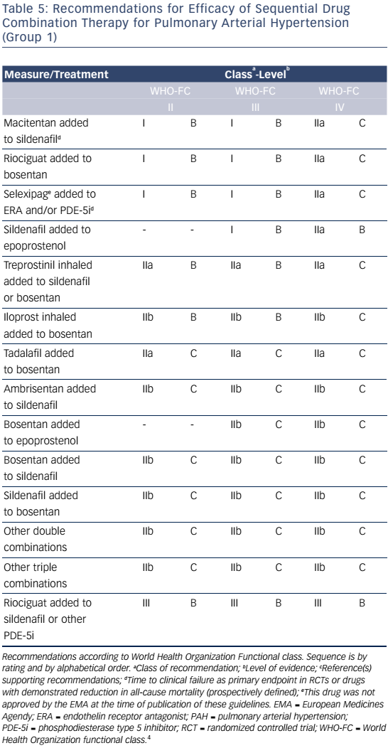
Attridge RL, Moote RD, Levine DJ
Table 5: Recommendations For Efficacy Of Sequential Drug Combination Therapy For Pulmonary Arterial Hypertension
Citation: US Cardiology Review 2016;10(2):78–84
https://doi.org/10.15420/usc.2016:2:2

