Slide 1
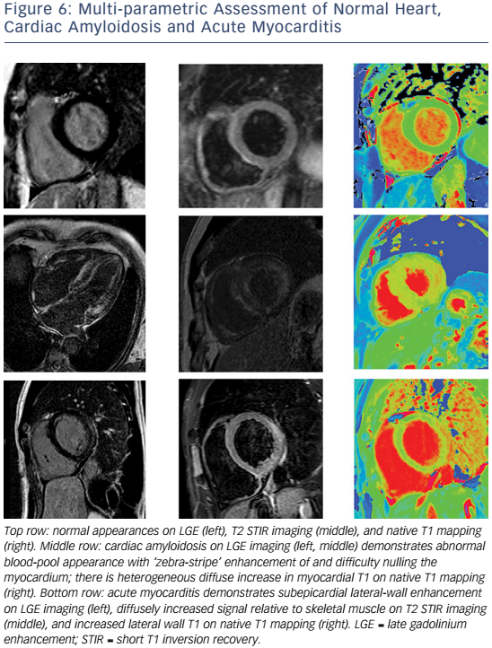
Peterzan MA, Rider OJ, Anderson L
Figure 6: Multi-Parametric Assessment Of Normal Heart, Cardiac Amyloidosis And Acute Myocarditis
Citation: Cardiac Failure Review, 2016;2(2):115–22
https://doi.org/10.15420/cfr.2016.2.2.115

