Slide 1
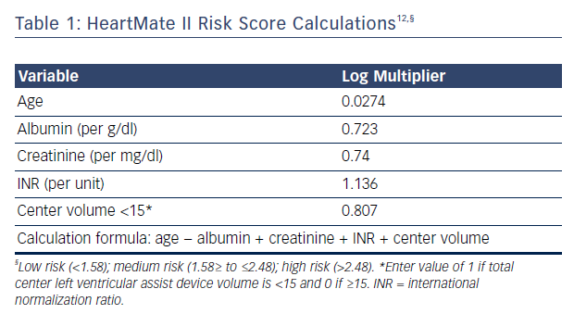
Enciso JS, Adler E, Greenberg BH
Table 1: HeartMate II Risk Score Calculations
Citation: US Cardiology Review 2016;10(2):85–90
https://doi.org/10.15420/usc.2016:6:2

