Slide 1

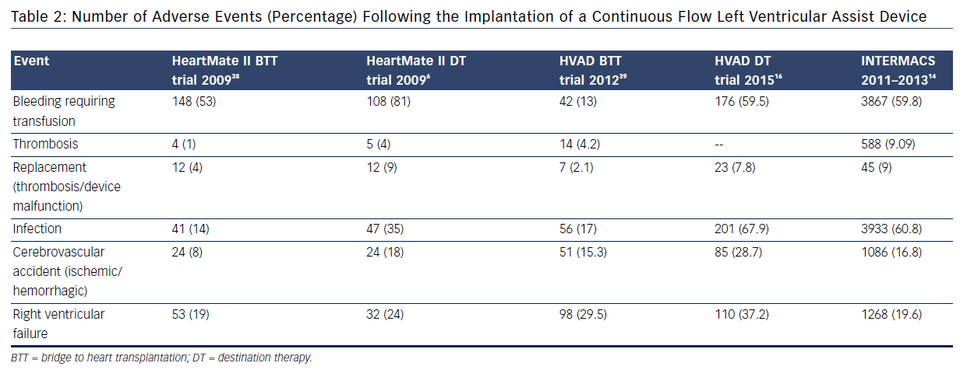
Enciso JS, Adler E, Greenberg BH
Table 2: Number of Adverse Events (Percentage) Following the Implantation of a Continuous Flow Left Ventricular Assist Device
Citation: US Cardiology Review 2016;10(2):85–90
https://doi.org/10.15420/usc.2016:6:2

