Slide 1
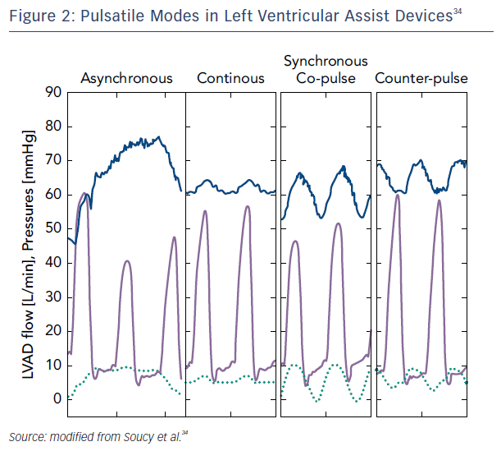
Enciso JS, Adler E, Greenberg BH
Figure 2: Pulsatile Modes in Left Ventricular Assist Devices
Citation: US Cardiology Review 2016;10(2):85–90
https://doi.org/10.15420/usc.2016:6:2

