Slide 1
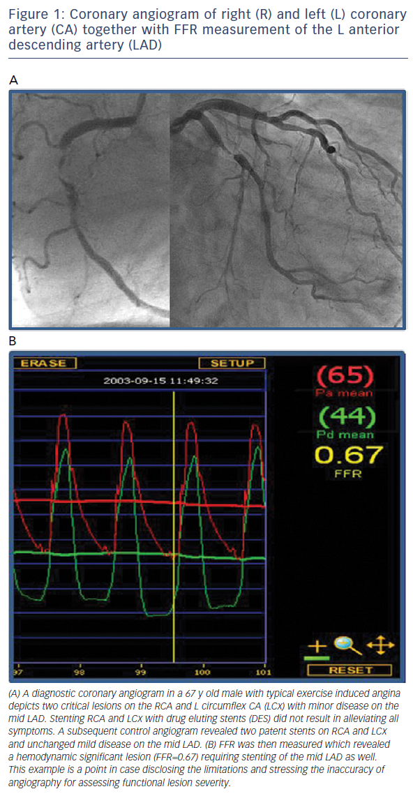
Heyndrickx GR, Tóth GG
Figure 1: Coronary angiogram of right (R) and left (L) coronary artery (CA) together with FFR measurement of the L anterior descending artery (LAD)
Citation: Interventional Cardiology Review, 2016;11(2):116–9
https://doi.org/10.15420/icr.2016:14:3

