Slide 1
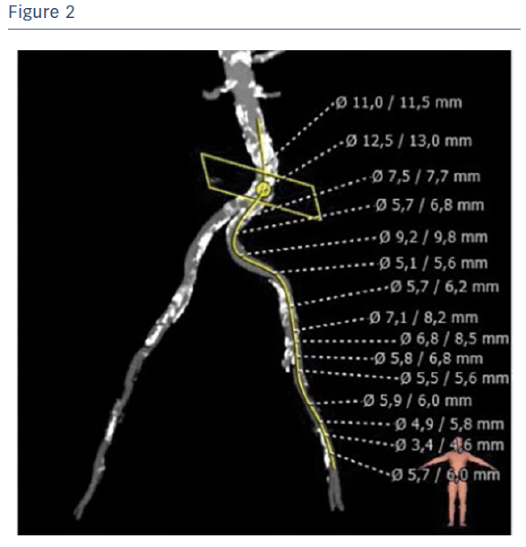
Sorropago G, Auguadro C, Sorropago A, Finizio M, Scalise F
Figure2
Citation: RadcliffeCardiology.com, September 2016

