Slide 1
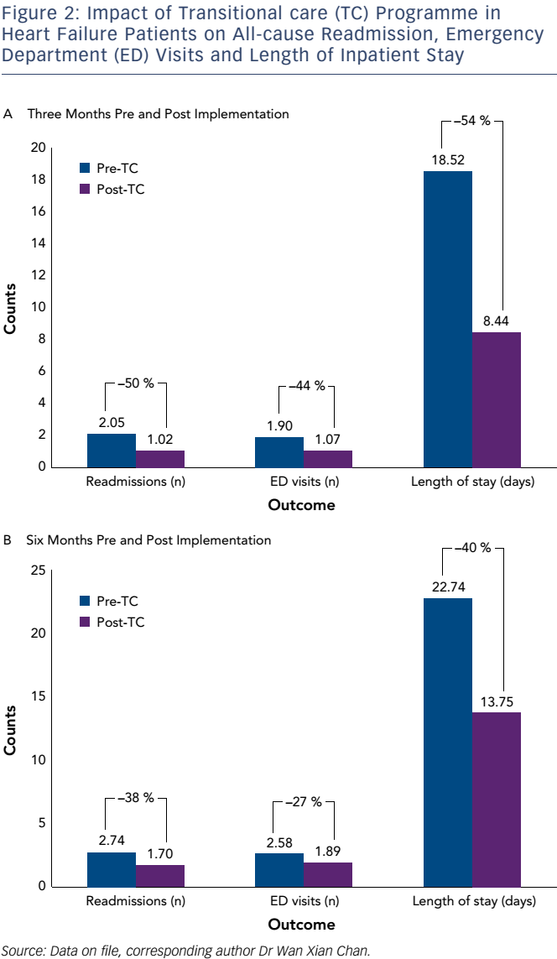
Chan WX, Lin W, Chiew Wong RC
Transitional Care to Reduce Heart Failure Readmission Rates in South East Asia
Citation: Cardiac Failure Review 2016;2(2):85–9
https://doi.org/10.15420/cfr.2016:9:2

