Slide 1
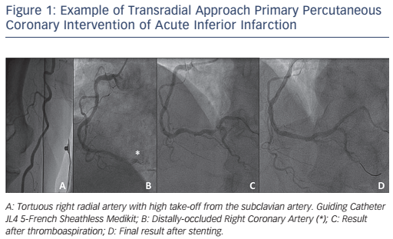
Piers LH, Vink MA, Amoroso G
Transradial Approach in Primary Percutaneous Coronary Intervention: Lessons from a High-volume Centre
Citation: Interventional Cardiology Review 2016;11 (2):88–92
https://doi.org/10.15420/icr.2016:21:3

