Slide 1
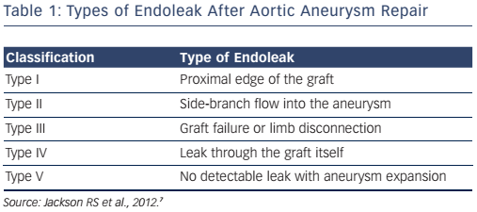
Cookman B, Allaqaband S, Nfor T
Table 1: Types of Endoleak After Aortic Aneurysm Repair
Citation: Interventional Cardiology Review 2016;11(2):128–34
https://doi.org/10.15420/icr.2016:8:2

