Slide 1

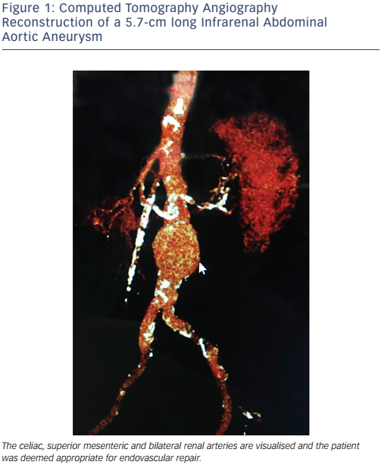
Cookman B, Allaqaband S, Nfor T
Figure 1: Computed Tomography Angiography&lt;br /&gt;&#10;Reconstruction of a 5.7-cm long Infrarenal Abdominal Aortic Aneurysm
Citation: Interventional Cardiology Review 2016;11(2):128–34
https://doi.org/10.15420/icr.2016:8:2

