Slide 1
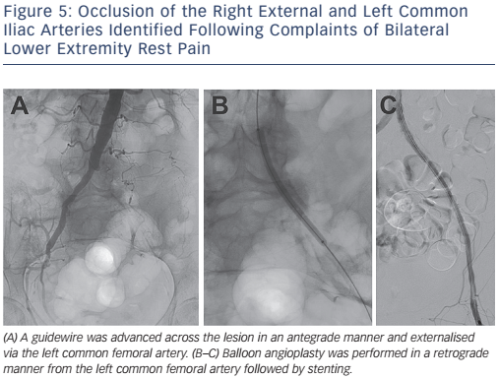
Cookman B, Allaqaband S, Nfor T
Figure 5: Occlusion of the Right External and Left Common Iliac Arteries Identified Following Complaints of Bilateral Lower Extremity Rest Pain
Citation: Interventional Cardiology Review 2016;11(2):128–34
https://doi.org/10.15420/icr.2016:8:2

