Slide 1
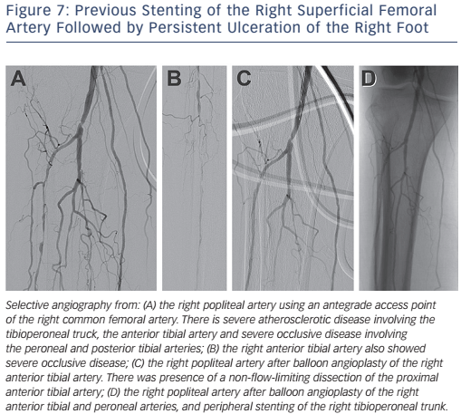
Cookman B, Allaqaband S, Nfor T
Figure 7: Previous Stenting of the Right Superficial Femoral Artery Followed by Persistent Ulceration of the Right Foot
Citation: Interventional Cardiology Review 2016;11(2):128–34
https://doi.org/10.15420/icr.2016:8:2

