Slide 1
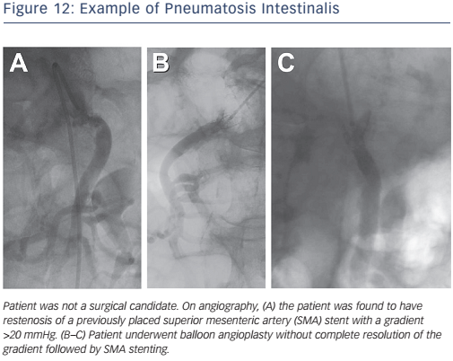
Cookman B, Allaqaband S, Nfor T
Figure 12: Example of Pneumatosis Intestinalis
Citation: Interventional Cardiology Review 2016;11(2):128–34
https://doi.org/10.15420/icr.2016:8:2

