Slide 1
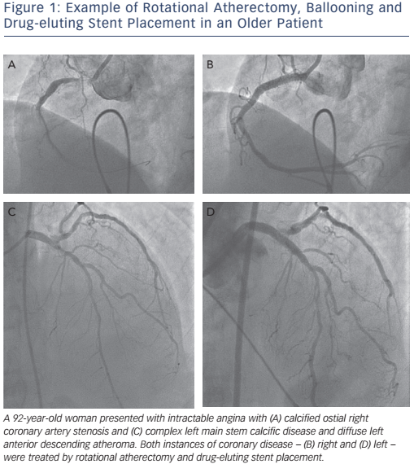
Omar SA, Belder Ad
Figure 1: Example of Rotational Atherectomy, Ballooning and Drug-eluting Stent Placement in an Older Patient
Citation: Interventional Cardiology Review 2016;11(2):93–7
https://doi.org/10.15420/icr.2016:20:2

