Slide 1
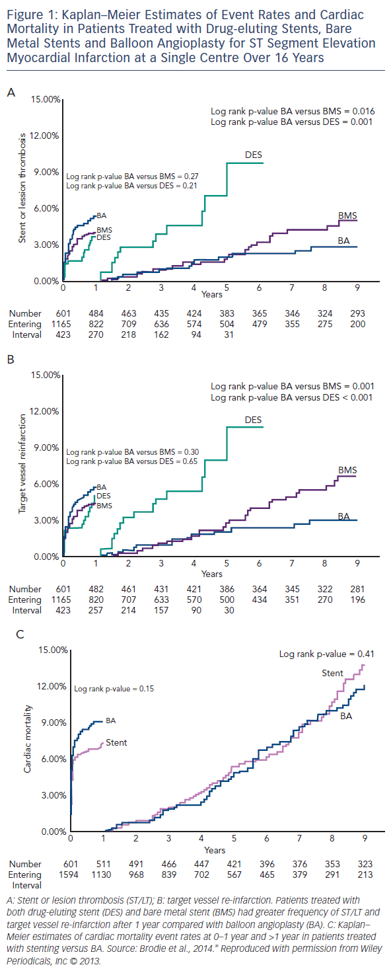
Wickramarachchi U, Eccleshall S
Kaplan–Meier Estimates of Event Rates and Cardiac Mortality in Patients Treated with Drug-eluting Stents, Bare Metal Stents and Balloon Angioplasty for ST Segment Elevation Myocardial Infarction at a Single Centre Over 16 Years
Citation: Interventional Cardiology Review 2016;11(2):110–5
https://doi.org/10.15420/icr.2016:17:3

