Slide 1
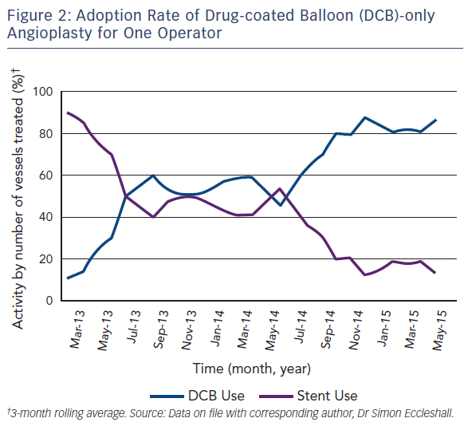
Wickramarachchi U, Eccleshall S
Figure 2: Adoption Rate of Drug-coated Balloon (DCB)-only Angioplasty for One Operator
Citation: Interventional Cardiology Review 2016;11(2):110–5
https://doi.org/10.15420/icr.2016:17:3

