Slide 1
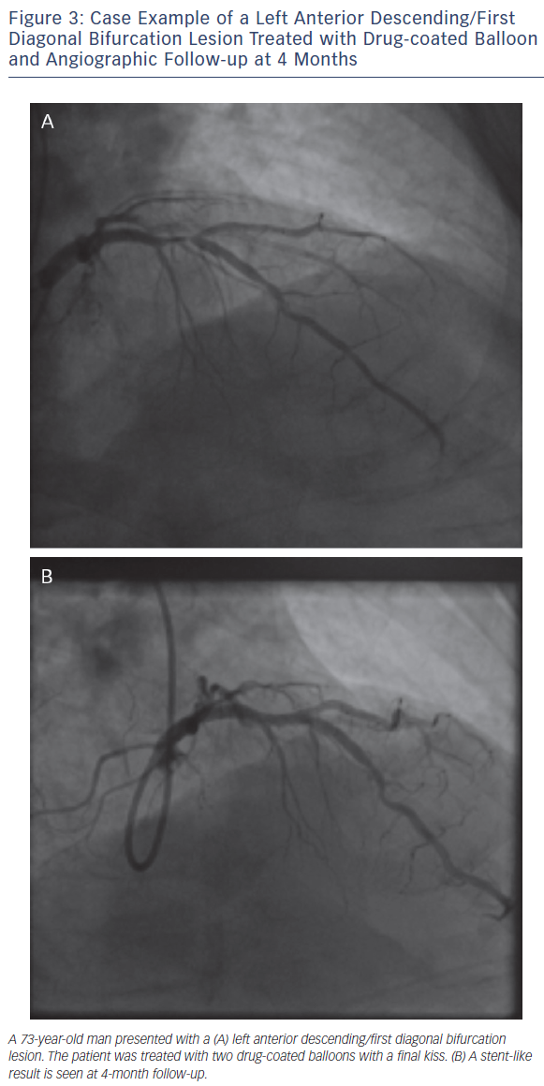
Wickramarachchi U, Eccleshall S
Figure 3: Case Example of a Left Anterior Descending/First Diagonal Bifurcation Lesion Treated with Drug-coated Balloon and Angiographic Follow-up at 4 Months
Citation: Interventional Cardiology Review 2016;11(2):110–5
https://doi.org/10.15420/icr.2016:17:3

