Slide 1
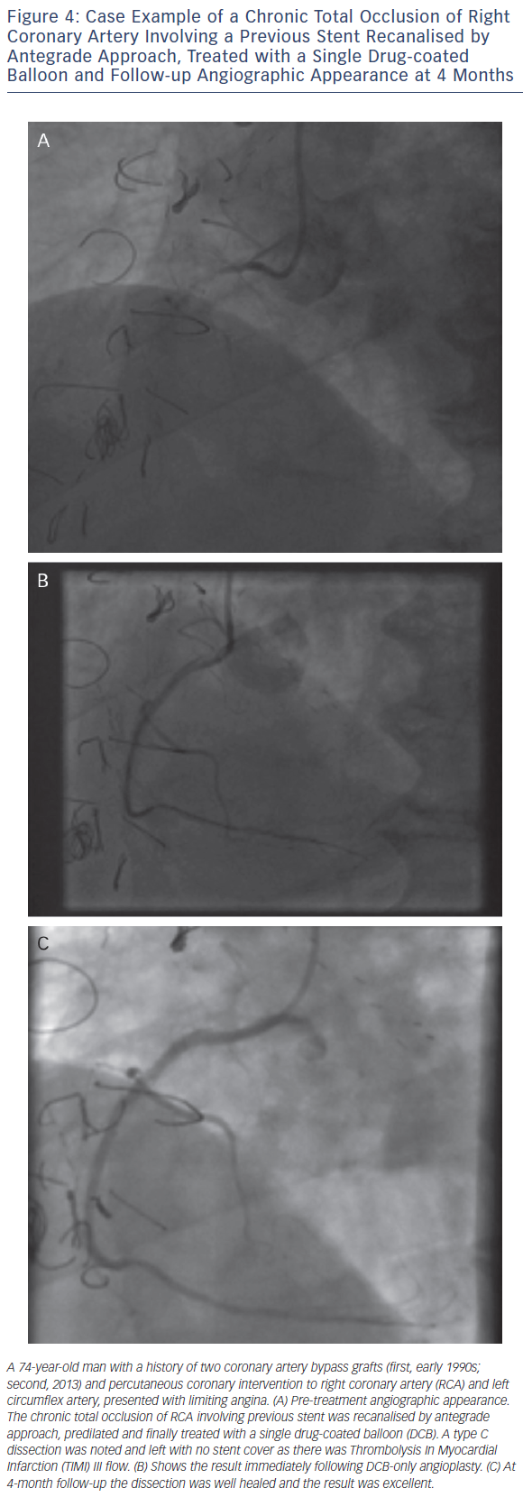
Wickramarachchi U, Eccleshall S
Figure 4: Case Example of a Chronic Total Occlusion of Right Coronary Artery Involving a Previous Stent Recanalised by Antegrade Approach, Treated with a Single Drug-coated Balloon and Follow-up Angiographic Appearance at 4 Months
Citation: Interventional Cardiology Review 2016;11(2):110–5
https://doi.org/10.15420/icr.2016:17:3

