Slide 1
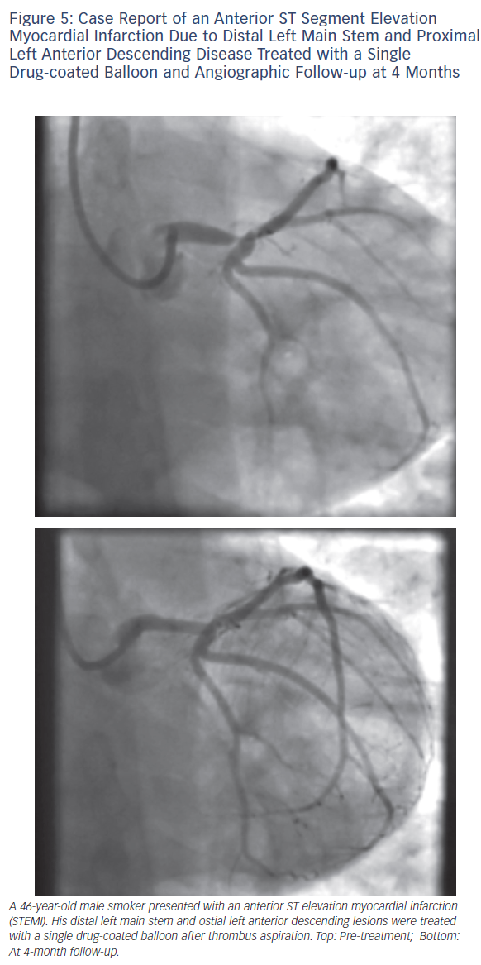
Wickramarachchi U, Eccleshall S
Case Report of an Anterior ST Segment Elevation Myocardial Infarction Due to Distal Left Main Stem and Proximal Left Anterior Descending Disease Treated with a Single Drug-coated Balloon and Angiographic Follow-up at 4 Months
Citation: Interventional Cardiology Review 2016;11(2):110–5
https://doi.org/10.15420/icr.2016:17:3

