Slide 1
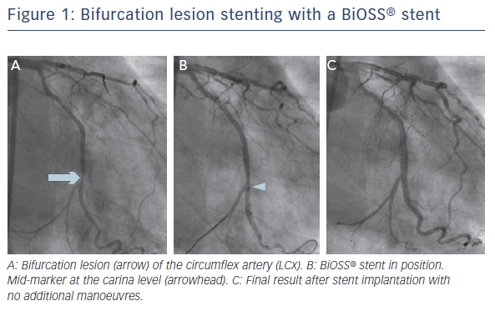
Lesiak M
Figure 1: Bifurcation lesion stenting with a BiOSS® stent
Citation: Interventional Cardiology Review 2016;11(2):124–7
https://doi.org/10.15420/icr.2016:22:2

