Slide 1
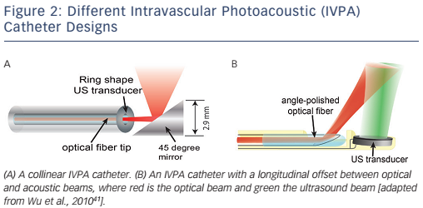
Wu M, van der Steen AF, Regar E, van Soest G
Figure 2: Different Intravascular Photoacoustic (IVPA) Catheter Designs
Citation: Interventional Cardiology Review 2016;11(2):120–3
https://doi.org/10.15420/icr.2016:13:3

