Slide 1
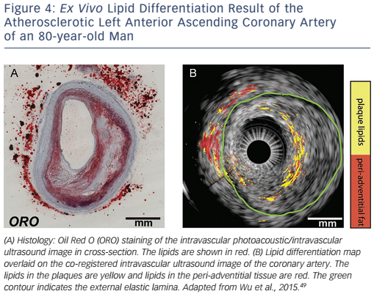
Wu M, van der Steen AF, Regar E, van Soest G
Figure 4: Ex Vivo Lipid Differentiation Result of the Atherosclerotic Left Anterior Ascending Coronary Artery of an 80-year-old Man
Citation: Interventional Cardiology Review 2016;11(2):120–3
https://doi.org/10.15420/icr.2016:13:3

