Slide 1
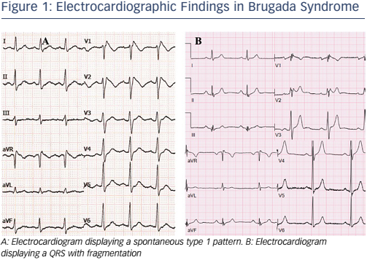
Sieira J, Brugada P
Electrocardiographic Findings in Brugada Syndrome
Citation: Arrhythmia & Electrophysiology Review 2016;5(3):164–9
https://doi.org/10.15420/aer.2016:22:3

