Slide 1
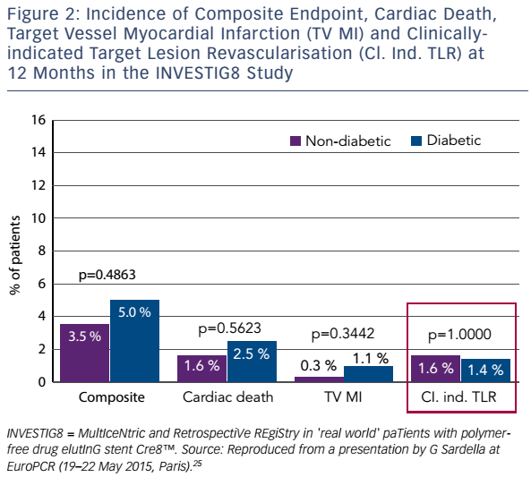
Byrne RA, Eeckhout E, Sardella G, Stella P, Verheye S
Figure 2: Incidence of Composite Endpoint, Cardiac Death, Target Vessel Myocardial Infarction (TV MI) and Clinically-indicated Target Lesion Revascularisation (Cl. Ind. TLR) at 12 Months in the INVESTIG8 Study
Citation: Interventional Cardiology Review 2017;12(1):13–7
https://doi.org/10.15420/icr.2016:28:2

