Slide 1
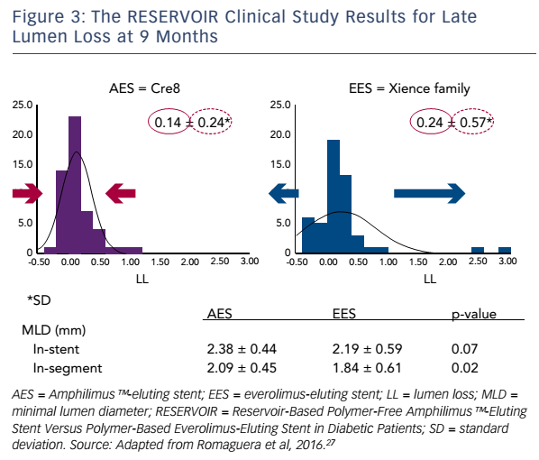
Byrne RA, Eeckhout E, Sardella G, Stella P, Verheye S
Figure 3: The RESERVOIR Clinical Study Results for Late Lumen Loss at 9 Months
Citation: Interventional Cardiology Review 2017;12(1):13–7
https://doi.org/10.15420/icr.2016:28:2

