Slide 1
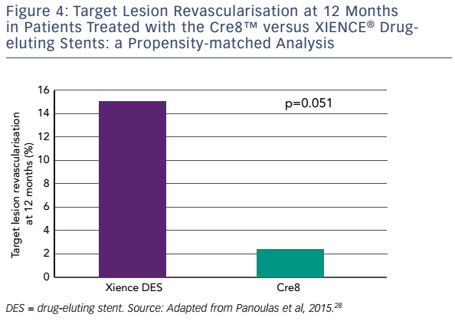
Byrne RA, Eeckhout E, Sardella G, Stella P, Verheye S
Figure 4: Target Lesion Revascularisation at 12 Months in Patients Treated with the Cre8™ versus XIENCE® Drug-&lt;br /&gt;&#10;eluting Stents: a Propensity-matched Analysis
Citation: Interventional Cardiology Review 2017;12(1):13–7
https://doi.org/10.15420/icr.2016:28:2

