Slide 1
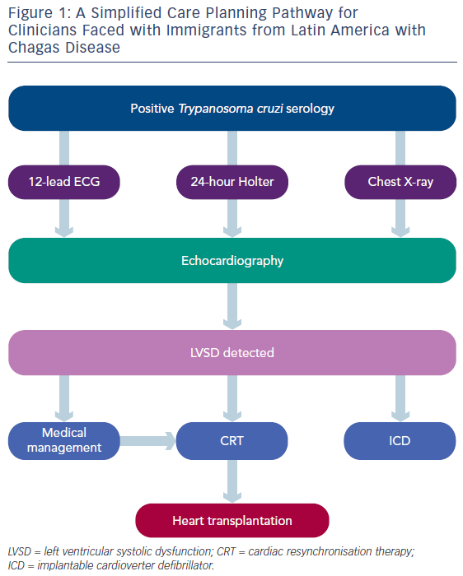
Bestetti RB
Chagas Heart Failure in Patients from Latin America
Citation: Cardiac Failure Review 2016;2(2):90–4
https://doi.org/10.15420/cfr.2016:14:2

