Slide 1
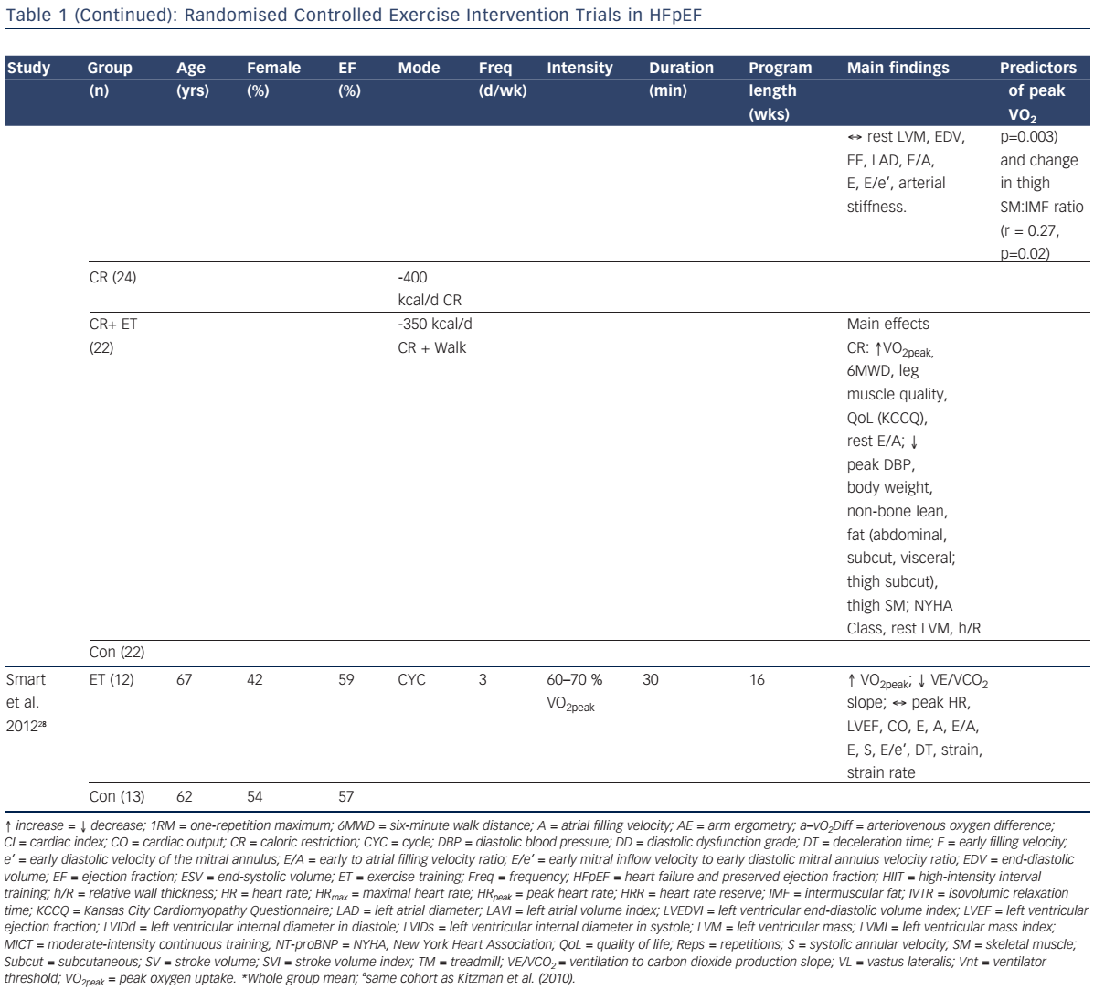
Tucker WJ, Nelson MD, Beaudry RI, Halle M, Sarma S, Kitzman DW, La Gerche A, Haykowsky MJ
Impact of Exercise Training on Peak Oxygen Uptake and its Determinants in Heart Failure with Preserved Ejection Fraction
Citation: Cardiac Failure Review 2016;2(2):95–101
https://doi.org/10.15420/cfr.2016:16:2

