Slide 1
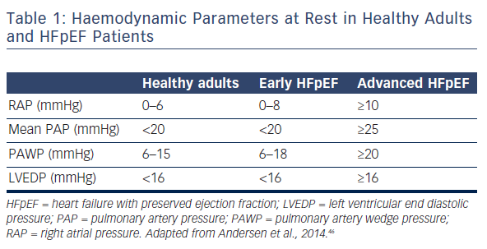
Gori M, Iacovoni A, Senni M
Table 1: Haemodynamic Parameters at Rest in Healthy Adults and HFpEF Patients
Citation: Cardiac Failure Review 2016;2(2):102–5
https://doi.org/10.15420/cfr.2016:17:2

