Slide 1
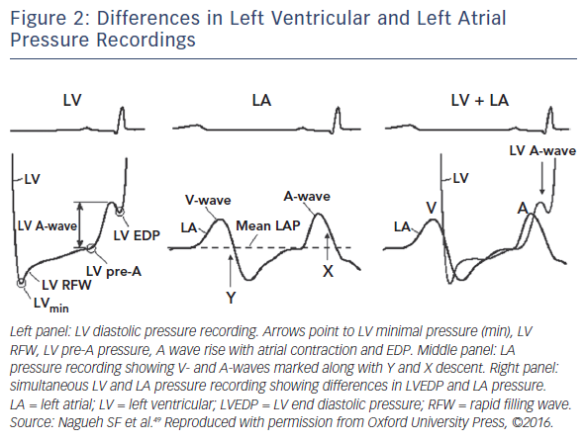
Gori M, Iacovoni A, Senni M
Figure 2: Differences in Left Ventricular and Left Atrial Pressure Recordings
Citation: Cardiac Failure Review 2016;2(2):102–5
https://doi.org/10.15420/cfr.2016:17:2

