Slide 1

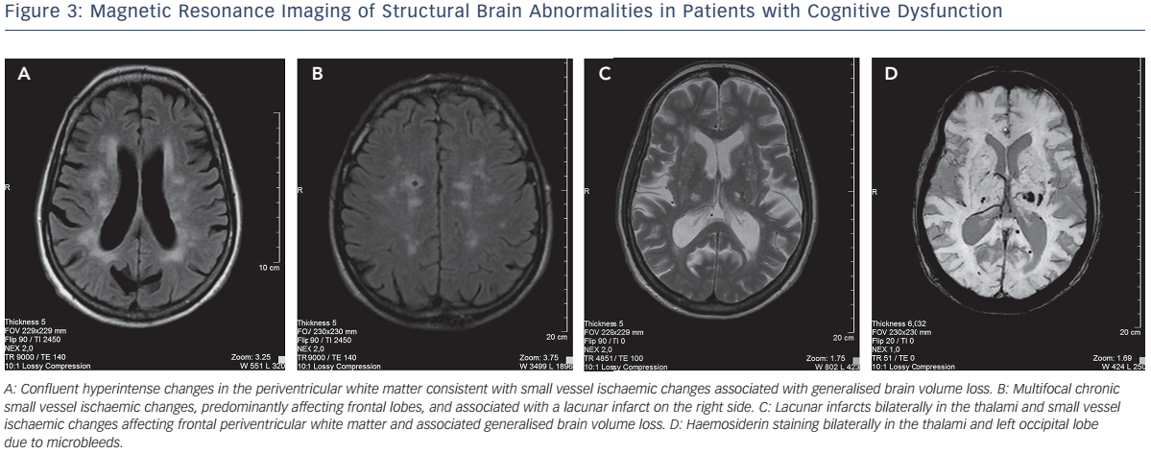
Celutkiene J, Vaitkevicius A, Jakstiene S, Jatuzis D
Cognitive Decline in Heart Failure: More Attention is Needed
Citation: Cardiac Failure Review 2016;2(2):106–9
https://doi.org/10.15420/cfr.2016:19:2

