Slide 1
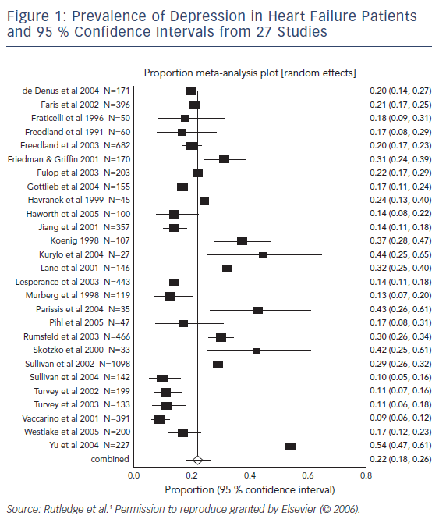
Mbakwem A, Aina F, Amadi C
Prevalence of Depression in Heart Failure Patients and 95 % Confidence Intervals from 27 Studies
Citation: Cardiac Failure Review 2016;2(2):110–2
https://doi.org/10.15420/cfr.2016:21:1

