Slide 1
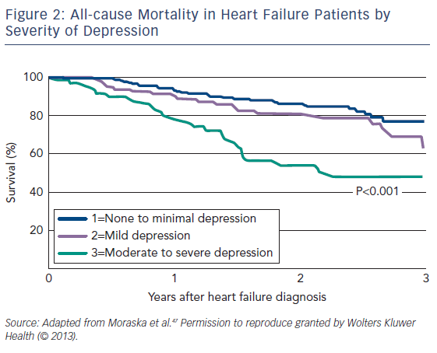
Mbakwem A, Aina F, Amadi C
Figure 2: All-cause Mortality in Heart Failure Patients by Severity of Depression
Citation: Cardiac Failure Review 2016;2(2):110–2
https://doi.org/10.15420/cfr.2016:21:1

