Slide 1
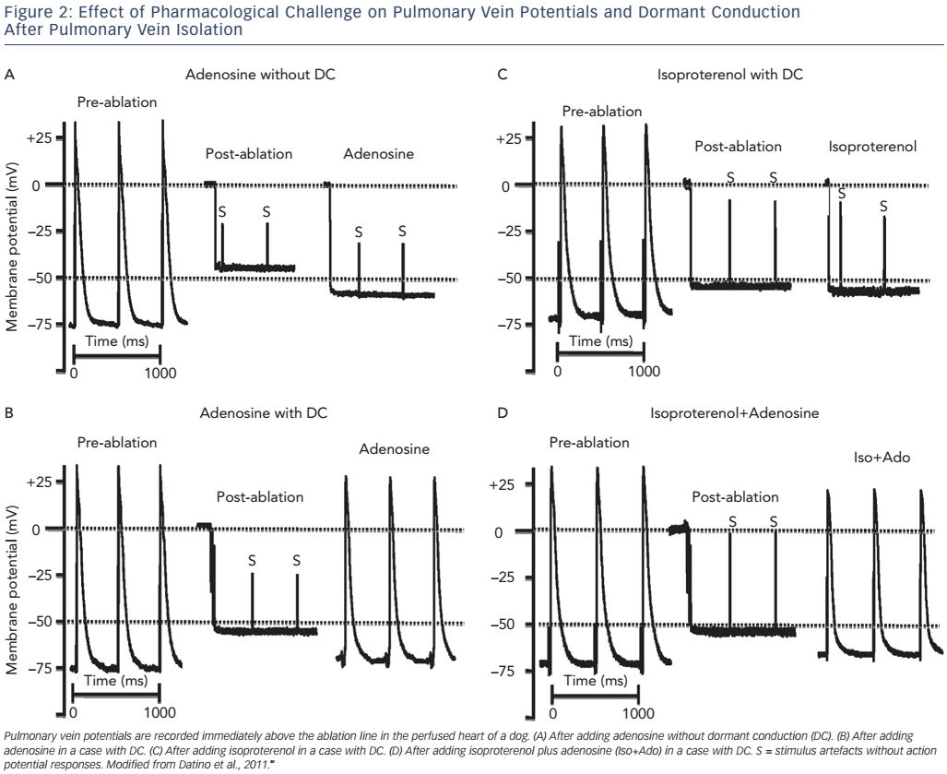
Gourraud JB, Andrade JG, Macle L, Mondésert B
Effect of Pharmacolpgical Challenge
Citation: Arrhythmia & Electrophysiology Review 2016;5(3):170–6
https://doi.org/10.15420/aer.2016:27:2

