Slide 1
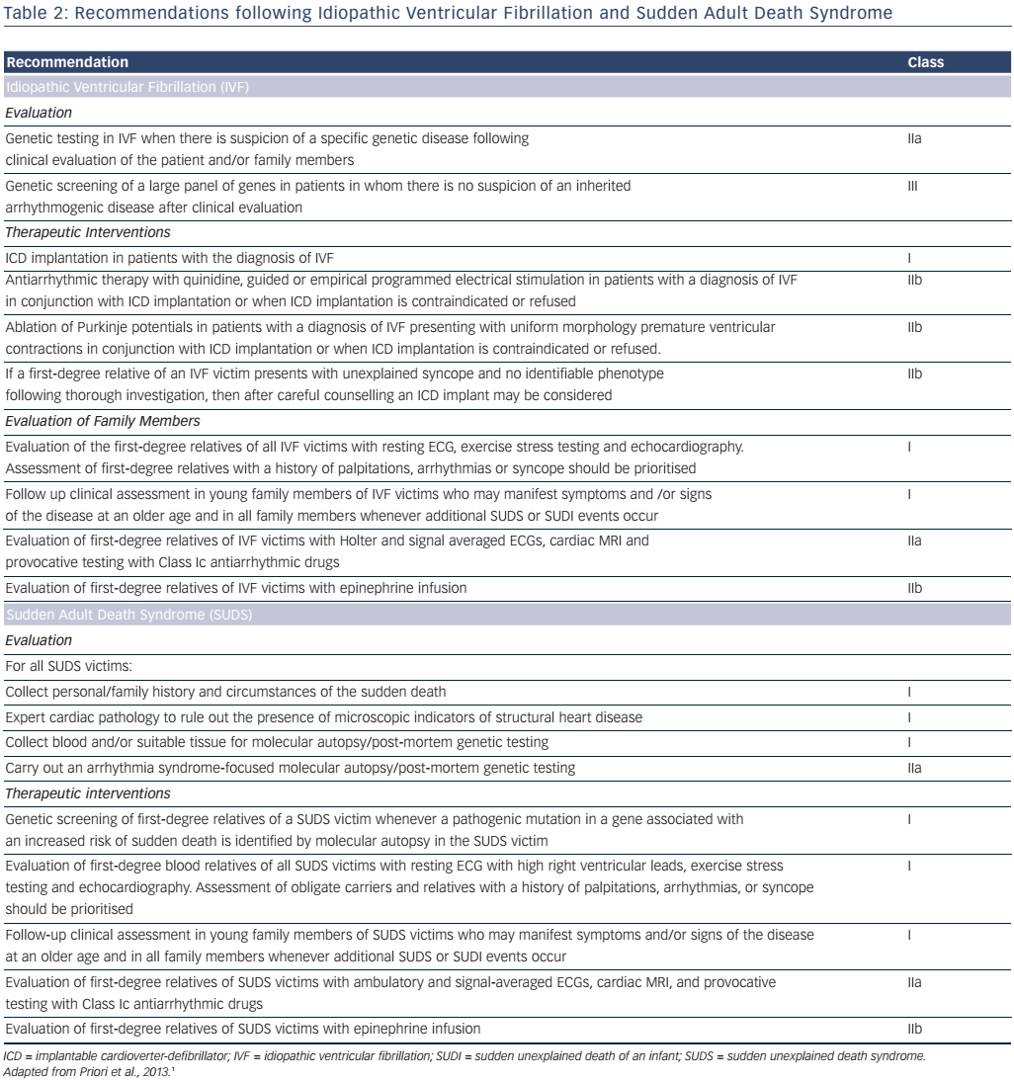
Katritsis DG, Gersh BJ, Camm AJ
A Clinical Perspective on Sudden Cardiac Death
Citation: Arrhythmia & Electrophysiology Review 2016;5(3):177–82
https://doi.org/10.15420/aer.2016:11:2

